Slide 1
AZ-220T01
Module 11:
Build an IoT Solution with IoT Central

Slide 2
Lesson 01: Learning objectives

Slide 3
Module 11 – Learning objectives
Describe the difference between Azure IoT Central and the Azure IoT PaaS services
Describe the features provided by Azure IoT Central
Describe the purpose and components of a Device Template
Create and publish a Device Template
Manage devices using rules and notifications
Manage devices at scale using jobs

Slide 4
Lesson 02: Introduction to IoT Central

Slide 5

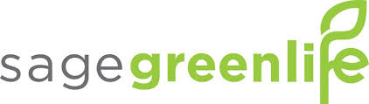
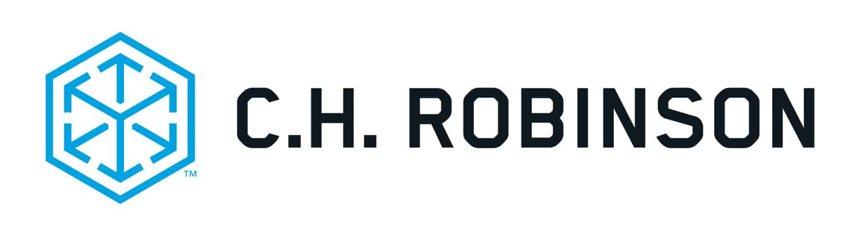
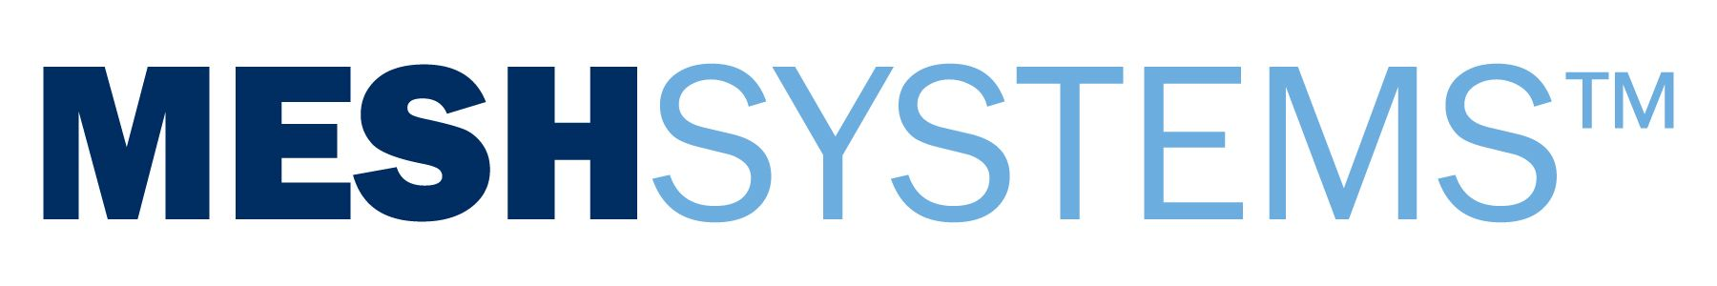


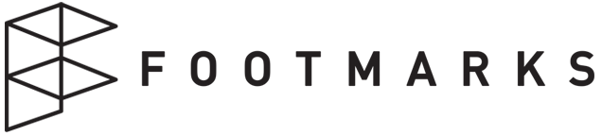
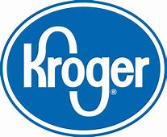
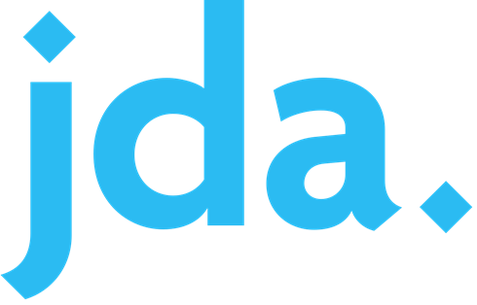


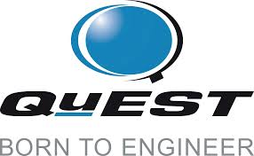

IoT Central
A fully managed IoT app platform that reduces the burden of building and maintaining IoT solutions.
Highly secure
Enterprise-grade
Predictable pricing
Industry-focused
Get connected
Connect IoT devices to the cloud faster than any other platform.
Stay connected
Reconfigure and update devices with centralized device management.
Transform
Bridge the gap with connectors
and extensibility APIs.
Existing solution builders
Notes:
Get connected - Azure IoT Central connects your IoT devices to the cloud faster than any other platform. Find new devices matched to your solution in the Azure Certified for IoT device catalog.
Stay connected - We understand how hard it is to keep devices connected and healthy. Reconfigure and update devices with centralized device management.
Transform - Our connectors and extensibility APIs bridge the gap between your business applications and IoT—a direct connection between IoT data and your decision makers.

Slide 6

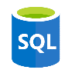


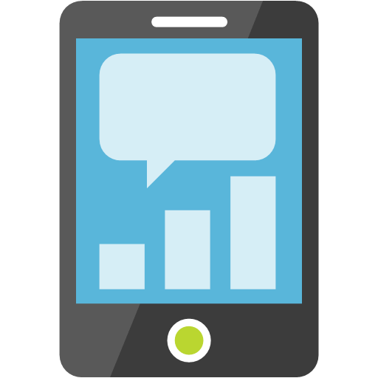

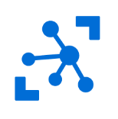
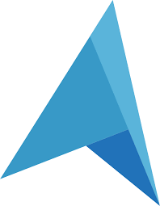



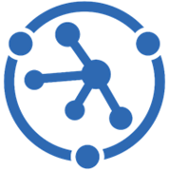
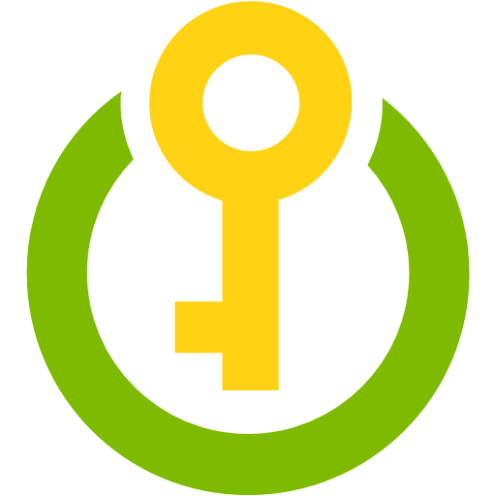
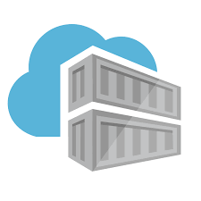
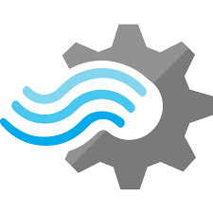


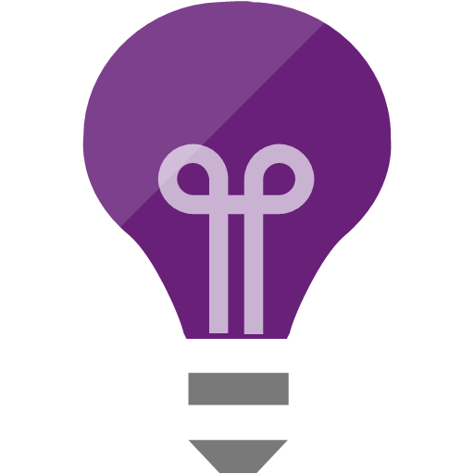

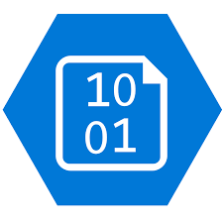
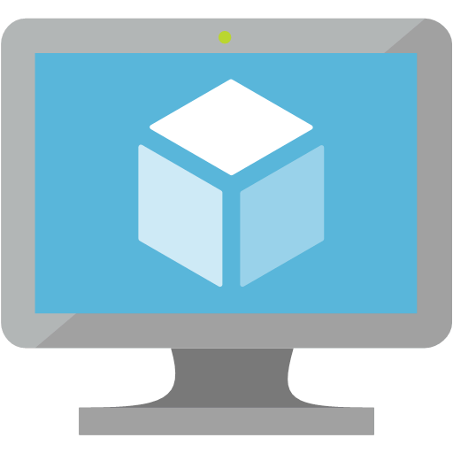
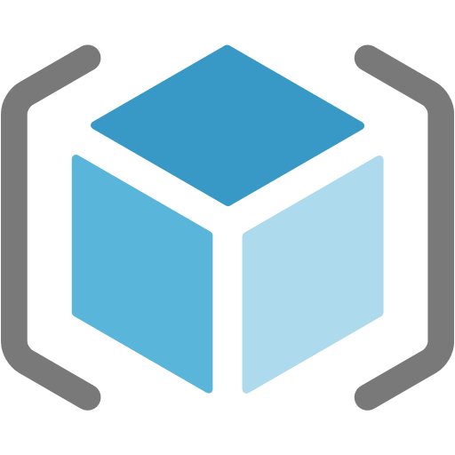


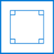
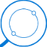
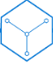




Your options for building IoT solutions
1. Build from the ground up
The issue: Designing, integrating and maintaining dozens of individual services requires extensive expertise, time and financial investment
Manage
View and manage solutions
Azure IoT Device SDK
  3rd Party Industry specific sensors & devices
  (RTOS, Linux, Windows, Android, iOS)
Functions
SQL Azure
Web Apps
Power BI
Mobile Apps
Edge Modules:
Protocol Adaptation
Functions
Stream Analytics
Machine Learning
AI
Event Hub
Maps
IoT Hub
PowerApps
Web Apps
Azure
IoT Edge
Device
Provisioning Service
Time Series Insights
Key Vault
Business Integration
Connect to business apps & services
Container
Registry
Azure Stream
Analytics
Cosmos DB
Data
Explorer
Application Insights
Dynamics 365
Kubernetes
Service
Office 365
Azure Sphere
Compute
(VMs)
Content
Delivery
Network
Storage
Resource
Manager
(ARM)
3rd Party applications
Domain
Name
System
Microsoft
Flow
Secured MCU
Secured OS
Cloud Security
Service Bus
Front Door
Integrated view for CISO & SecOps personas to review enterprise security posture, including IoT solutions.
Holistic view of IoT solution security posture for DevOps and IoT solution managers to review and manage day to day security status
Azure Security
Center for IoT
Notes:
“When a customer decides to implement an IoT solution, they often consider a do-it-yourself solution. However, as you can see on the slide, there’s a lot of moving parts that you would need to own if you’re going that route. We’ve covered the implementation of some these components in the course, but that’s not enough to build a complete solution. You could decide to manage all of these yourself, using the PaaS services we’ve already covered, or…” [next slide]

Slide 7

Your options for building IoT solutions
2. Build with a fully managed IoT app platform
Functions
Manage
View and manage solutions
Azure IoT Device SDK
  3rd Party Industry specific sensors & devices
  (RTOS, Linux, Windows, Android, iOS)
SQL Azure
Web Apps
Azure IoT Central
Build with Azure IoT Central, our IoT App Platform
Functions
SQL Azure
Web Apps
Event Hub
Maps
Power BI
Mobile Apps
Simplify production-ready IoT solution development
Simplify setup, reduce management burden, operational costs, and overhead of a typical IoT project.
Bring solutions to market faster, while staying focused on your customers
IoT Hub
Device
Provisioning Service
Maps
Edge Modules:
Protocol Adaptation
Functions
Stream Analytics
Machine Learning
AI
Event Hub
PowerApps
Web Apps
IoT Hub
Time Series Insights
Azure
IoT Edge
Device
Provisioning Service
Key Vault
Azure Stream
Analytics
Cosmos DB
Time Series Insights
Container
Registry
Data
Explorer
Key Vault
Business Integration
Connect to business apps & services
Highly secure
Enterprise-grade
Application Insights
Predictable pricing
Industry-focused
Container
Registry
Kubernetes
Service
Azure Stream
Analytics
Cosmos DB
Data
Explorer
Compute
(VMs)
Application Insights
Dynamics 365
Kubernetes
Service
Content
Delivery
Network
Storage
Resource
Manager
(ARM)
Azure Sphere
Domain
Name
System
Office 365
Storage
Compute
(VMs)
Microsoft
Flow
Domain
Name
System
Service Bus
Content
Delivery
Network
Front Door
Resource
Manager
(ARM)
3rd Party applications
Microsoft
Flow
Secured MCU
Secured OS
Cloud Security
Service Bus
Front Door
Integrated view for CISO & SecOps personas to review enterprise security posture, including IoT solutions.
Holistic view of IoT solution security posture for DevOps and IoT solution managers to review and manage day to day security status
Azure Security
Center for IoT
Notes:
https://docs.microsoft.com/en-us/azure/iot-central/core/overview-iot-central
“You can use Microsoft Azure IoT Central, which manages many of the PaaS components into an application platform… notice that in the central core, many of the components that you would have had to manage are now being managed for you by the Azure IoT Central Core.”
“Of course, you can also extend Azure IoT Central to other systems; the left side of this slide shows how many different devices (directly or through other systems, or even other clouds) can connect to Azure IoT Central, and the right side of the slide shows how you can do things like continuous data export, business integration such as to the Logic Apps service we described earlier in the course, and so on… ”

Slide 8
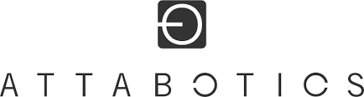
IoT Central
A fully managed IoT app platform that reduces the burden of building and maintaining IoT solutions.
Highly secure
Enterprise-grade
Predictable pricing
Industry-focused
Get connected
Connect IoT devices to the cloud faster than any other platform.
Stay connected
Reconfigure and update devices with centralized device management.
Transform
Bridge the gap with connectors
and extensibility APIs.
Existing solution builders
Notes:
Get connected - Azure IoT Central connects your IoT devices to the cloud faster than any other platform. Find new devices matched to your solution in the Azure Certified for IoT device catalog.
Stay connected - We understand how hard it is to keep devices connected and healthy. Reconfigure and update devices with centralized device management.
Transform - Our connectors and extensibility APIs bridge the gap between your business applications and IoT—a direct connection between IoT data and your decision makers.

Slide 9
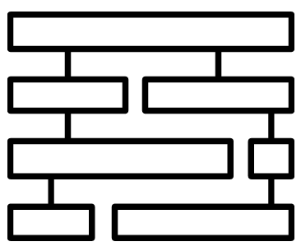
Azure IoT Central
Get Connected
Connect IoT devices to the cloud faster than with any other platform
Stay Connected
Reconfigure and update devices with centralized device management
Transform
Bridge the gap with connectors and extensibility APIs
Device connectivity and
management
Telemetry ingestion and
command & control
Industry-focused
Application Templates
Edge support
Dashboards, visualization
& insights
White Labeling
Device Modeling
Monitoring rules &
triggered actions
Multitenancy
End to End Security
User roles and
permissions
Extensibility & Customization
IoT Central public APIs

Slide 10
IoT Central
NEW
Pricing in February 2020
  App templates
  for Industry Verticals
  White labeling
  your SaaS – your brand
  Azure IoT Edge support
  API support
  IoT Plug and Play support
  New 2-tiered
  pricing model
  5,000
  messages
  /month
  /device
  30,000
  messages
  /month
  /device
  2
  devices
  free
  40c
  70c
Notes:
https://azure.microsoft.com/en-us/pricing/details/iot-central/

Slide 11
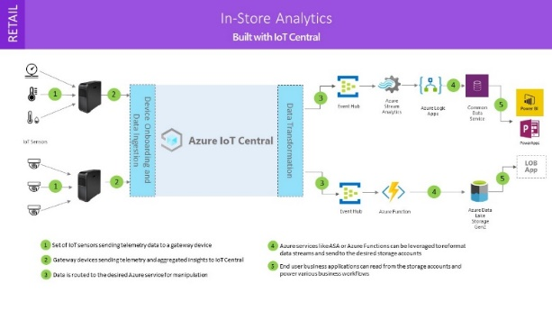
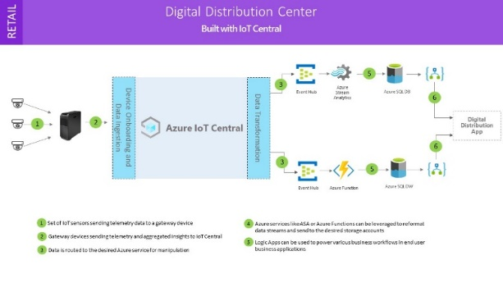
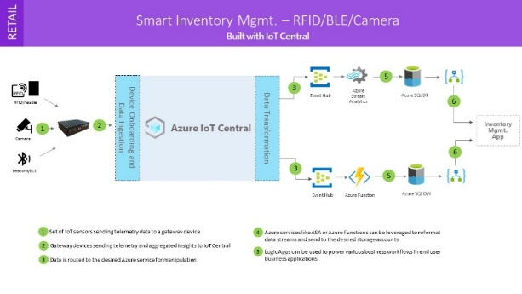
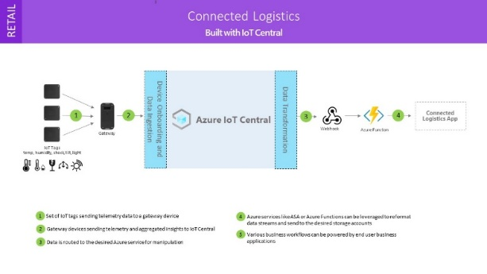
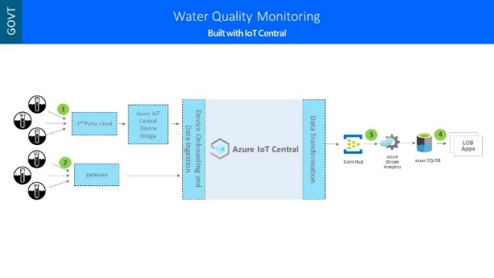
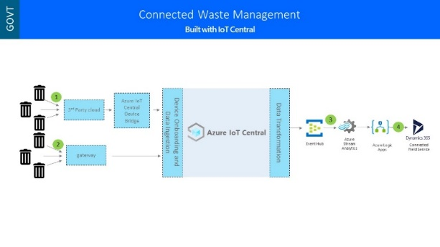
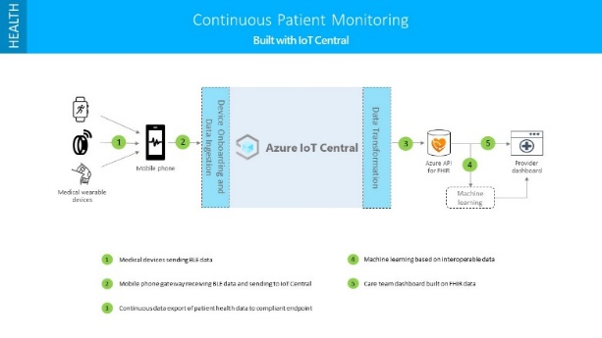
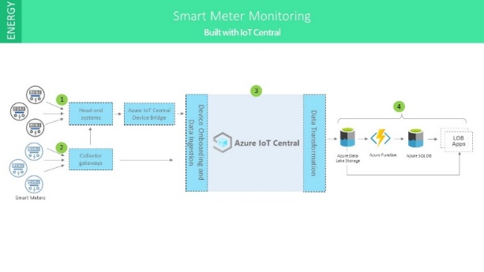
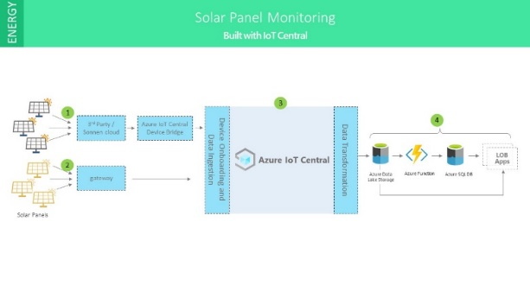
Industry Application Templates
Notes:
https://docs.microsoft.com/en-us/azure/iot-central/core/concepts-app-templates
Application templates in Azure IoT Central are a tool to help solution builders kickstart their IoT solution development. You can use app templates for everything from getting a feel for what is possible, to fully customizing and your application for resale to your customers.
Application templates consist of:
Sample operator dashboards
Sample device templates
Simulated devices producing real-time data
Pre-configured rules and jobs
Rich documentation including tutorials and how-tos
Retail
Connected logistics
Digital distribution center
In-store analytics - condition monitoring
In-store analytics - checkout
Smart Inventory Management
Energy
Smart meter monitoring
Solar panel monitoring
Government
Connected waste management
Water consumption monitoring
Water quality monitoring
Healthcare.
Continuous patient monitoring

Slide 12
Connecting Devices
Connect a single device
Connect devices at scale using SAS
Connect devices at scale using X.509 certificates
Connect without registering devices
Individual enrollment-based device connectivity
Device status
Notes:
https://docs.microsoft.com/en-us/azure/iot-central/core/concepts-get-connected
You may want to start creating an IoT Central instance here so you can begin demoing concepts to them.
Because they know about these concepts from DPS, which underlies what IoT Central is doing, you can go through this very quickly. The original source material for the course doesn’t assume you know DPS, so there’s a small disconnect there that we have to live with.
Note: We are leaving out two early-in-preview pieces here, IoT Plug and Play and IoT Azure Digital Twins. This is a deliberate course decision. If you as an instructor have knowledge of those, that’s fine. If you get asked about either of those, or wish to talk about them, be sure to check the current docs.microsoft.com content.

Slide 13
Lesson 03: Create and Manage Device Templates

Slide 14
Introduction to Device Templates
Device templates – blueprints for a device
  Device capability model – telemetry, properties, and commands for the device
  Cloud properties – IoT Central properties not shared with the device
  Customizations – allow overriding some of the capability model for an individual device such as property names
  Rules – monitoring workflows and actions (more in a later lesson)
  Dashboards and flows – visual display and configuration (more in a later lesson)
Options for creating a device template
  Create a device template from the device catalog
  Create a device template from scratch
Manage a device template
  Templates can be renamed or deleted
Notes:
https://docs.microsoft.com/en-us/azure/iot-central/core/howto-set-up-template

Slide 15
Device Template Example: A Connected Fan
Sends temperature telemetry
Sends location property
Sends fan motor error events
Sends fan operating state
Provides a writeable fan speed property
Provides a command to restart the device
Gives you an overall view of the device via a dashboard

Slide 16
Create a Device Capability Model
Approaches for Creating a Capability Model
  From scratch
  Import from a JSON file such as from Visual Studio Code
  Import from the device catalog
Manage a Capability Model
  Add interfaces to the model – a reusable collection of capabilities
  Edit model metadata such as its name
  Delete the model
Notes:
Remember capabilities are telemetry, properties, and commands

Slide 17
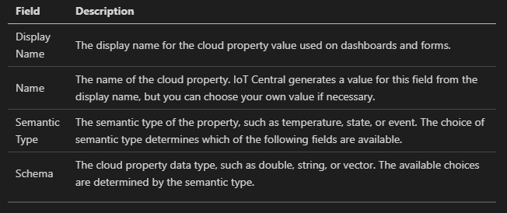
Add Cloud Properties to a Device Template

Slide 18
Add Customizations to a Device Template
Use customizations to modify a capability
  Display name and unit
  Default chart color
  Initial, minimum, and maximum values
Generate default views for visualization
  Commands – lists the device commands with a dispatch option
  Overview – device telemetry in charts and metric values
  About – device properties

Slide 19
Add Dashboards to a Device Template
Dashboards – enable operators to visualize devices
Includes charts and metrics
Configure preview device – option in the dashboard editor that allows viewing a running version of the dashboard, with data from:
  Nothing (no data)
  A test device
  A production device

Slide 20
Add Forms to a Device Template
Forms – enable operators to manage a device
Includes properties and editors for properties

Slide 21
Version a Device Template
Add customizations to the device template without versioning – as long as the interface is consistent
Versioning a Device Template
Migrate a device across device template versions

Slide 22
Lesson 04: Manage Devices in Azure IoT Central

Slide 23
Manage Your Devices
View Your Devices
Add a Device
Import devices
Export devices
Delete a device
Change a property
Notes:
https://docs.microsoft.com/en-us/azure/iot-central/core/howto-manage-devices

Slide 24
Introduction to Device Groups
Device group – collection of devices based on device properties
Can be displayed on a dashboard in a grid or on a map
Can be displayed in a customizable list view within the group
Analytics – tool to perform aggregation of telemetry data across a device group
Notes:
https://docs.microsoft.com/en-us/azure/iot-central/core/tutorial-use-device-groups

Slide 25
Manage Devices at Scale using Jobs
Jobs – Allow changing settings or properties or running commands across a collection of devices in a device set
Can be started and stopped on demand
Can be copied to make new templates
Notes:
https://docs.microsoft.com/en-us/azure/iot-central/core/howto-run-a-job

Slide 26
Lesson 05: Business Integration

Slide 27
What are Rules?
Rules - serve as a customizable response tool that trigger actions on actively monitored events from connected devices
Actions can be:
Email
Webhooks
Azure Monitor Action Groups
Target Device Data
Conditions
Actions
Notes:
https://docs.microsoft.com/en-us/azure/iot-central/core/howto-configure-rules
https://docs.microsoft.com/en-us/azure/iot-central/core/tutorial-create-telemetry-rules
https://docs.microsoft.com/en-us/azure/iot-central/core/howto-create-webhooks
https://docs.microsoft.com/en-us/azure/iot-central/core/howto-use-action-groups

Slide 28
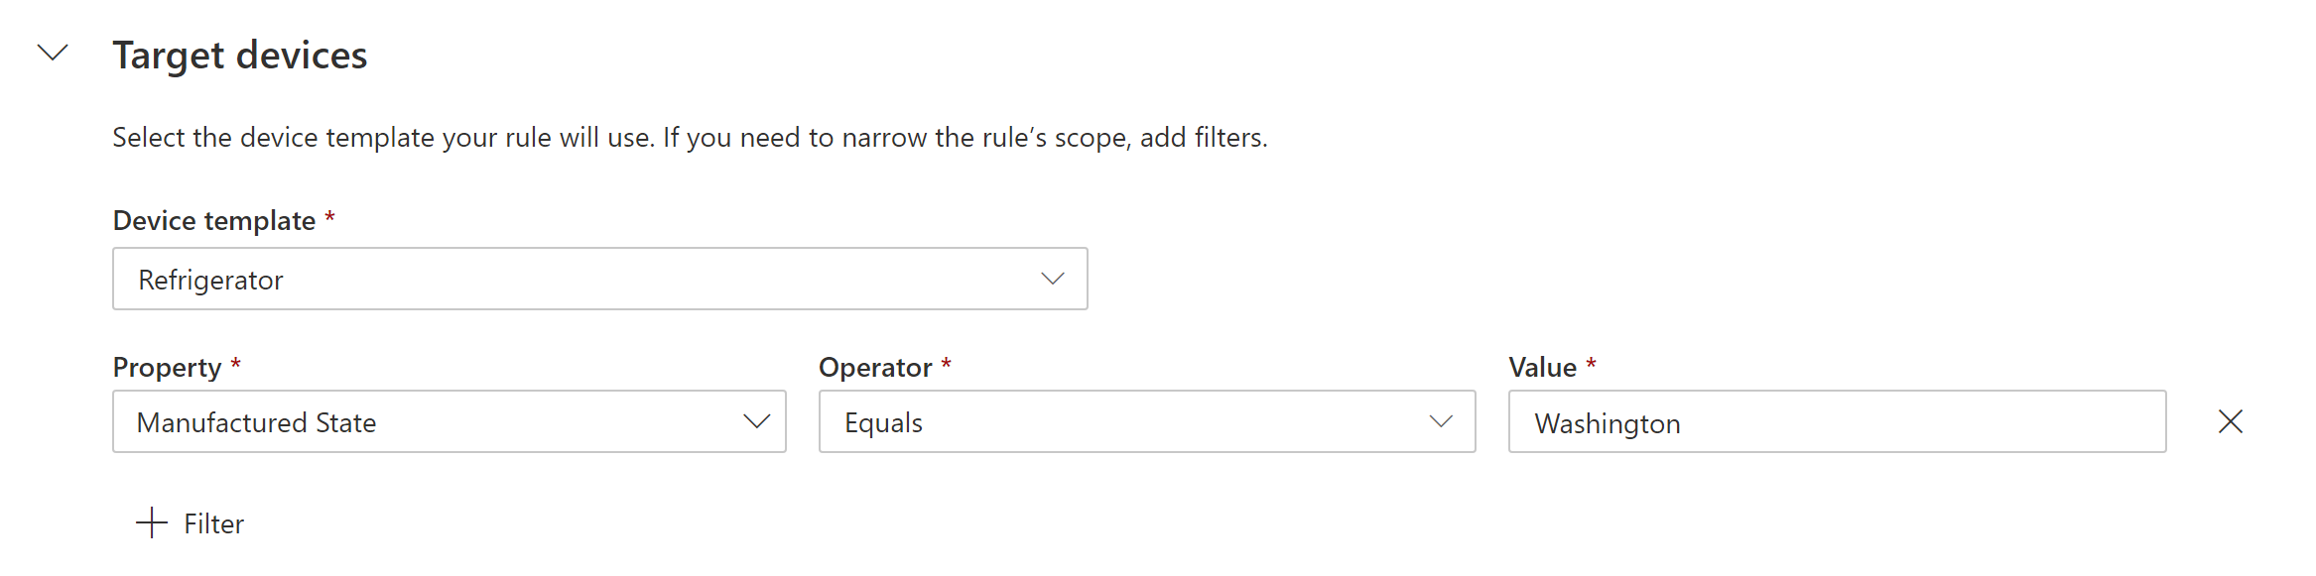
Configuring Rules (1/4)
Select Target Devices
Use multiple conditions
Use aggregate windowing
Use rules with IoT Edge modules

Slide 29
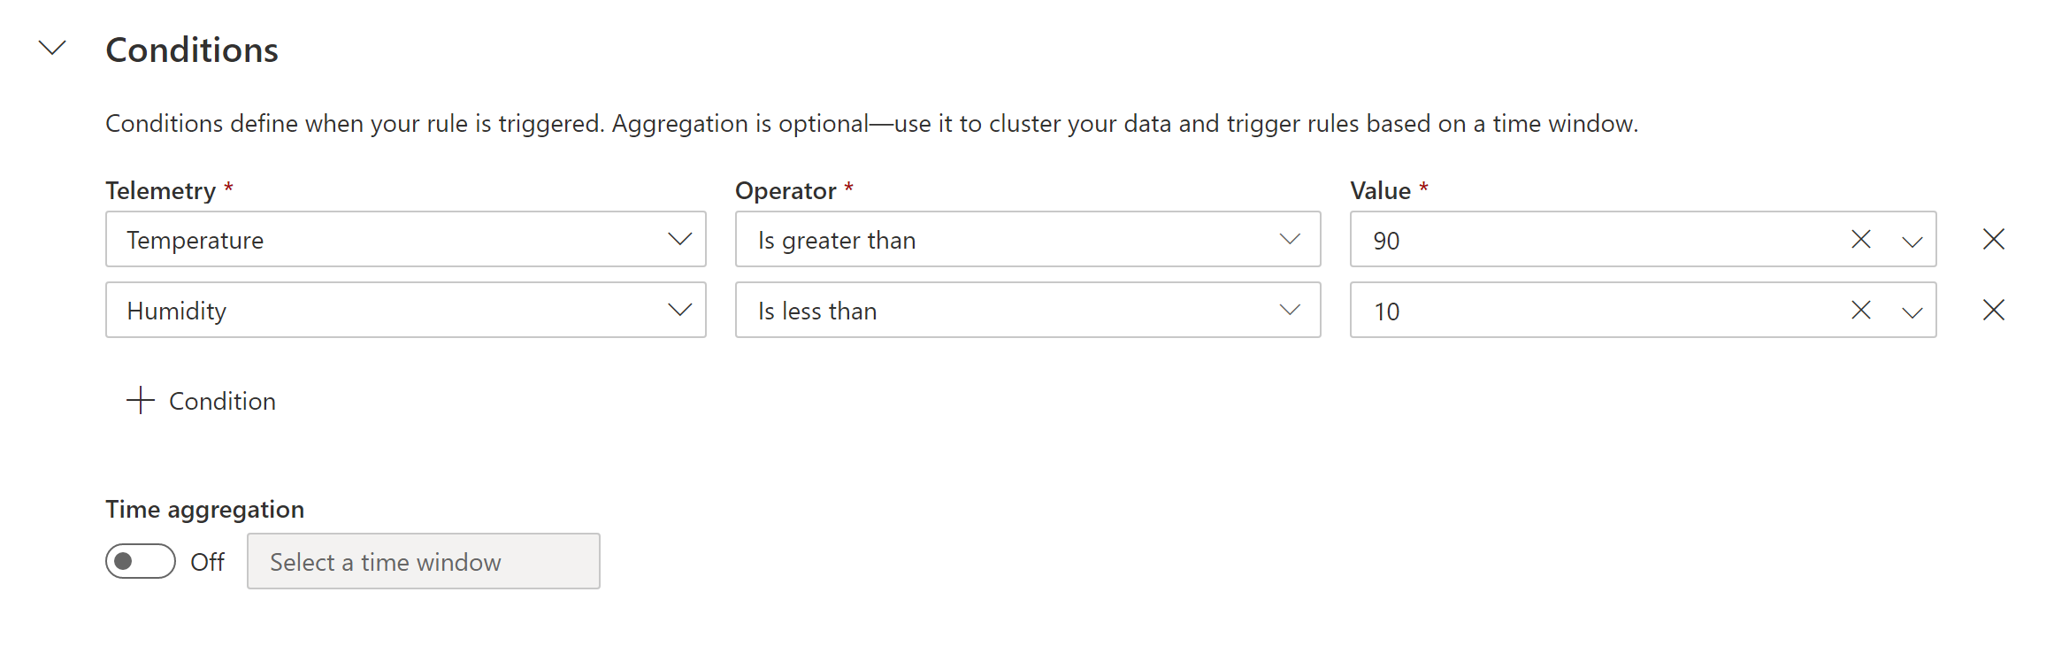
Configuring Rules (2/4)
Select Target Devices
Use multiple conditions
Use aggregate windowing
Use rules with IoT Edge modules
Notes:
With multiple conditions, all must be met (it’s an “AND”)

Slide 30
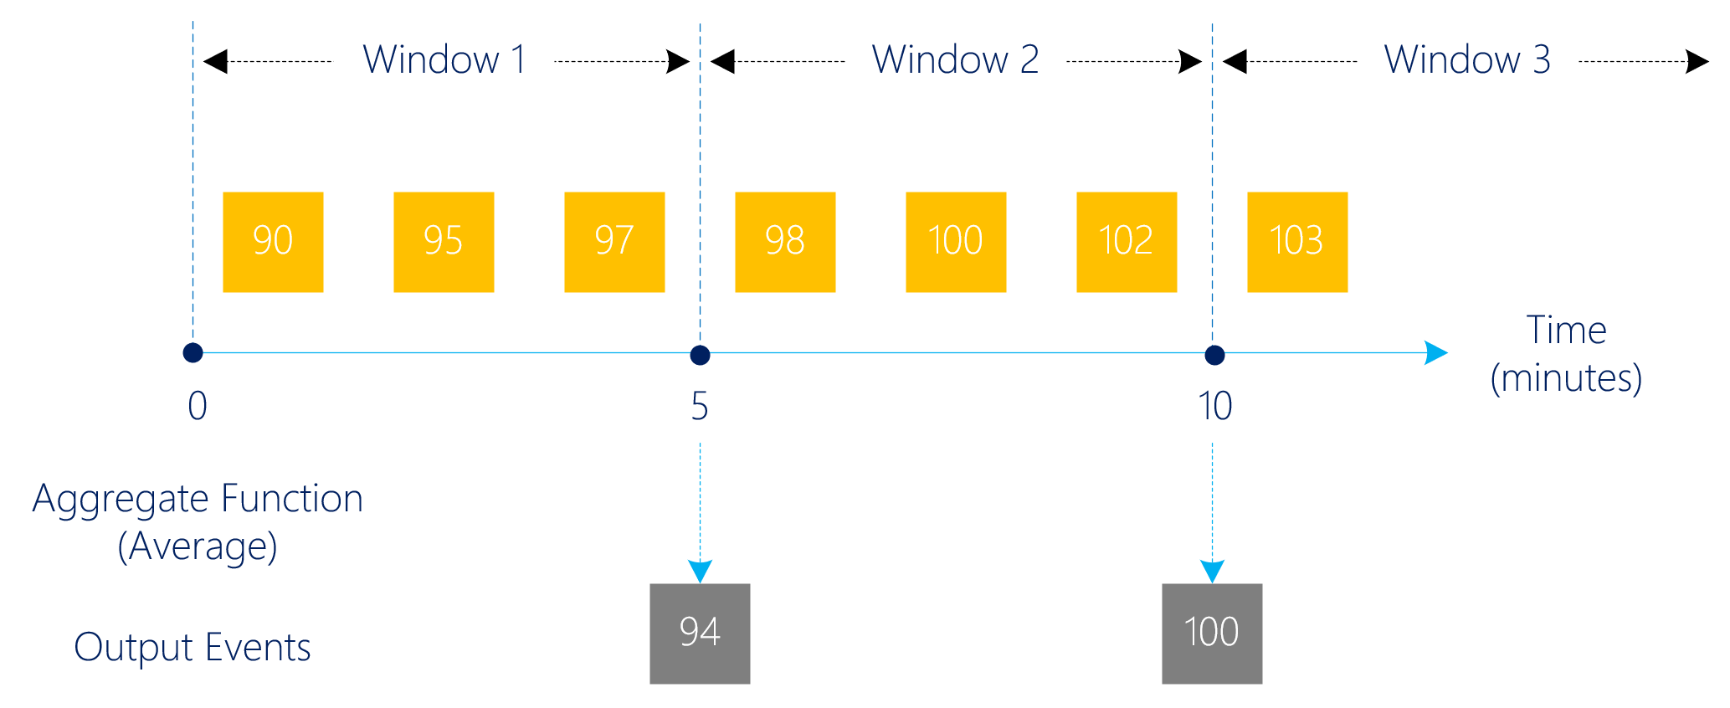
Configuring Rules (3/4)
Select Target Devices
Use multiple conditions
Use aggregate windowing
Use rules with IoT Edge modules
Notes:
Optionally, you can set a Time aggregation. When you select a time aggregation, you must also select an aggregation type, such as average or sum from the aggregation drop-down.
Without aggregation, the rule triggers for each telemetry data point that meets the condition. For example, if the rule is configured to trigger when temperature is above 70 then the rule triggers almost instantly when the device reports temperature > 70.
With aggregation, the rule triggers if the aggregate value of the telemetry data points in the time window meets the condition. For example, if the rule is configured to trigger when temperature is above 70, time aggregation is set to 10 minutes, and the aggregation type is average, then the rule triggers when the device reports an average temperature > 70, calculated over a 10-minute interval.

Slide 31
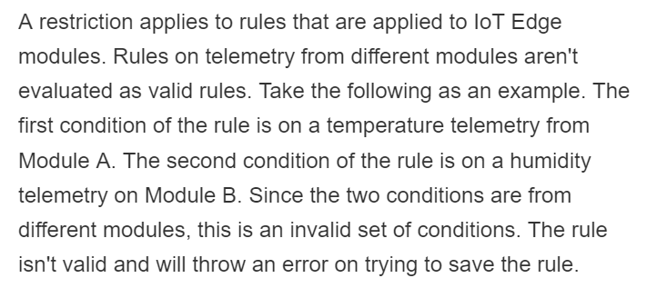
Configuring Rules (4/4)
Select Target Devices
Use multiple conditions
Use aggregate windowing
Use rules with IoT Edge modules
Notes:
https://docs.microsoft.com/en-us/azure/iot-central/core/howto-configure-rules#use-rules-with-iot-edge-modules

Slide 32
Create a Rule and Set Up Notifications
Name the rule
Optionally, filter the devices the rule applies to
Configure the Rule Conditions
Configure actions (email, Webhooks, Azure Monitor Action Groups)
Manage rules for devices
  Delete
  Enable or Disable globally
  Enable or Disable for a specific device through the rule filter

Slide 33
Continuous Data Export
Continuous data export – the ability to send ongoing streams of data (telemetry, device property changes, device template changes) to Event Hubs, Service Bus, or Blob Storage in JSON format
Useful for warm path scenarios such as Azure Stream Analytics, Azure Logic Apps, or Azure Function-based transformations
Useful for cold path scenarios such as training Azure Machine Learning or long-term trend analysis
Includes full message data
Near-realtime for Event Hubs and Service Bus, once per minute for Blob Storage
Notes:
https://docs.microsoft.com/en-us/azure/iot-central/core/howto-export-data

Slide 34
Lesson 06: Data Visualization and Analysis

Slide 35
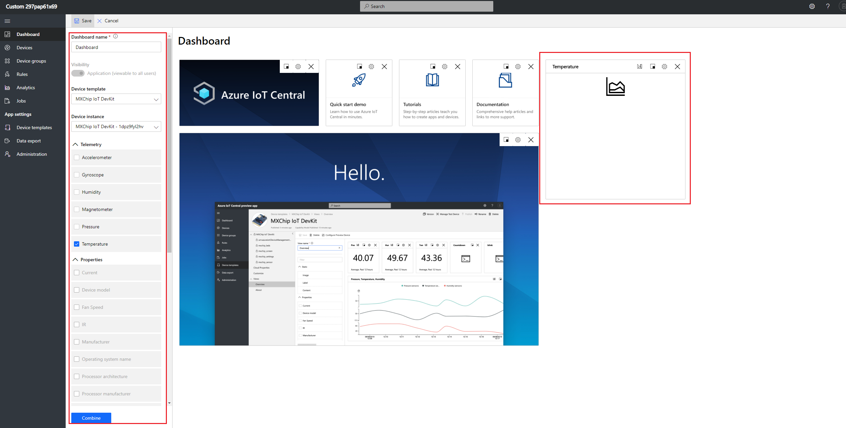
Configure a Dashboard
Add Tiles
Edit Tiles
Tile Types
Notes:
https://docs.microsoft.com/en-us/azure/iot-central/core/howto-create-personal-dashboards

Slide 36
Analyze Your Device Data
Understanding the Analytics UI
  You select the devices, the telemetry values, and the aggregation methods
  You select the analysis duration and interval size within the duration
  You can choose to display data on a line chart
  You can split data by device properties to change the data display or aggregation buckets (can even be set to “Device Id” for per-device viewing)
Notes:
https://docs.microsoft.com/en-us/azure/iot-central/core/howto-create-analytics

Slide 37
Lesson 07: Module Labs

Slide 38
Module 11 Labs
Lab 20: Build an IoT Solution with IoT Central

Slide 39
Lesson 08: Module 11 review questions

Slide 40
Module Review: Question 11.1
You are developing an Azure IoT solution your company. You have a small team and limited experience with IoT technologies. You decide to investigate Azure IoT Central.
What is Azure IoT Central? (choose one best answer)
Azure IoT Central is a simple dashboard for reviewing Azure Monitor logs.
Azure IoT Central is an IoT app platform that reduces the burden and cost of developing, managing, and maintaining enterprise-grade IoT solutions.
Azure IoT Central is another name for Azure IoT Hub.
Azure IoT Central is a helper service for IoT Hub that enables zero-touch, just-in-time provisioning to the right IoT hub without requiring human intervention.
Notes:
Correct Answer: B
Explanation: In the student workbook/skillpipe content, topic What is Azure IoT Central includes the following:
Azure IoT Central is an IoT app platform that reduces the burden and cost of developing, managing, and maintaining enterprise-grade IoT solutions. Choosing to build with Azure IoT Central gives you the opportunity to focus your time, money, and energy on transforming your business with IoT data, rather than just maintaining and updating a complex and continually evolving IoT infrastructure.
Create your Azure IoT Central application
As a solution builder, you use Azure IoT Central to create a custom, cloud-hosted IoT solution for your organization. A custom IoT solution typically consists of:
- A cloud-based application that receives telemetry from your devices and enables you to manage those devices.
- Multiple devices running custom code connected to your cloud-based application.

Slide 41
Module Review: Question 11.2
You are developing an Azure IoT solution your company. You have a small team and limited experience with IoT technologies. You decide to investigate Azure IoT Central.
Which of the following statements accurately describe IoT Central? (choose all correct answers)
Azure IoT Central app platform is built on top of the Azure IoT PaaS services.
Azure IoT Central uses Azure IoT Hub as a cloud gateway that enables device connectivity.
Azure IoT Central uses device templates to specify the data that a device can exchange with your application.
Azure IoT Central supports connections to IoT devices, but Azure IoT Edge devices are not supported.
Notes:
Correct Answer: A, B, C
Explanation: In the student workbook/skillpipe content, topic Azure IoT Central Architecture includes the following:
Azure IoT Central app platform is built on top of the Azure IoT PaaS services
Azure IoT Central is not limited to IoT devices, you can also connect Azure IoT Edge devices to an IoT Central application.
In Azure IoT Central, the data that a device can exchange with your application is specified in a device template.
Azure IoT Central uses Azure IoT Hub as a cloud gateway that enables device connectivity.

Slide 42
Module Review: Question 11.3
You are developing an Azure IoT solution your company. You have a small team and limited experience with IoT technologies. You choose Azure IoT Central as the platform for your solution. You start building your solution using the UI provided. Shortly after getting started you see that you will need to create a device template.
What are the four components of a device template? (choose all correct answers)
Device capability model
Device connectivity model
Cloud properties
Views
Controls
Customizations
Notes:
Correct Answer: A, C, D, F
Explanation: In the student workbook/skillpipe content, topic Azure IoT Central Architecture includes the following:
IoT Central device templates provide a device definition that includes:
- Device capability model: Device capability models specify the capabilities of a device such as the telemetry it sends, the properties that define the device state, and the commands the device responds to. Device capabilities are organized into one or more interfaces.
- Cloud properties: Cloud properties specify the properties IoT Central stores for a device. These properties are only stored in IoT Central and are never sent to a device.
- Views: Views specify the dashboards and forms the builder creates to let the operator monitor and manage the devices.
- Customizations: Customizations let the builder override some of the definitions in the device capability model to make them more relevant to the IoT Central application.
An IoT Central application can have one or more simulated and real devices based on each device template.
In an Azure IoT Central application, you can create and run jobs to manage connected devices. These jobs let you do bulk updates to device properties or settings, or run commands. For example, you can create a job to increase the fan speed for multiple refrigerated vending machines.

Slide 43
Module Review: Question 11.4
You are developing an Azure IoT solution your company. You have a small team and limited experience with IoT technologies. You choose Azure IoT Central as the platform for your solution. You start building your solution using the UI provided. Although the documentation provides the guidance you need to create your application, it becomes clear that you still need to plan your solution architecture.
Which of the following statements about an IoT Central solution are correct? (choose all correct answers)
An IoT Central application can have multiple devices based on each device template.
Cloud properties specify the properties IoT Central stores for a device.
Cloud properties let the builder override some of the definitions in the device capability model.
IoT Central jobs enable you do bulk updates to device properties or settings and provide the ability to run commands.
Notes:
Correct Answer: A, B, D
Explanation: In the student workbook/skillpipe content, topic Azure IoT Central Architecture includes the following:
IoT Central device templates provide a device definition that includes:
- Device capability model: Device capability models specify the capabilities of a device such as the telemetry it sends, the properties that define the device state, and the commands the device responds to. Device capabilities are organized into one or more interfaces.
- Cloud properties: Cloud properties specify the properties IoT Central stores for a device. These properties are only stored in IoT Central and are never sent to a device.
- Views: Views specify the dashboards and forms the builder creates to let the operator monitor and manage the devices.
- Customizations: Customizations let the builder override some of the definitions in the device capability model to make them more relevant to the IoT Central application.
An IoT Central application can have one or more simulated and real devices based on each device template.
In an Azure IoT Central application, you can create and run jobs to manage connected devices. These jobs enable you do bulk updates to device properties or settings and provide the ability to run commands. For example, you can create a job to increase the fan speed for multiple refrigerated vending machines.

Slide 44
Module Review: Question 11.5
You are part of a small team that’s using Azure IoT Central to build an IoT solution for your company. Your solution architecture calls for the implementation of both IoT devices and IoT Edge devices. During an early POC phase, a consultant demonstrated device code that uses the sensors you selected for your solution. Since you have a limited budget, you want to leverage the initial work that you have already paid for.
Which of the following could be valid options for creating your device templates? (choose all correct answers)
Create a device template using a preconfigured item from the Azure Certified for IoT device catalog.
Create a device template using IoT Hub.
Create a device template from scratch by building each component yourself.
Create a device template based on a device capability model that you developed using Visual Studio Code.
Notes:
Correct Answer: A, C, D
Explanation: In the student workbook/skillpipe content, topic Introduction to Device Templates includes the following:
Creating a device template
As a builder, you have several options for creating device templates:
- Design the device template in IoT Central, and then implement its device capability model in your device code.
- Import a device capability model from the Azure Certified for IoT device catalog. Then add any cloud properties, customizations, and dashboards your IoT Central application needs.
- Create a device capability model by using Visual Studio Code. Implement your device code from the model. Manually import the device capability model into your IoT Central application, and then add any cloud properties, customizations, and dashboards your IoT Central application needs.
- Create a device capability model by using Visual Studio Code. Implement your device code from the model, and connect your real device to your IoT Central application by using a device-first connection. IoT Central finds and imports the device capability model from the public repository for you. You can then add any cloud properties, customizations, and dashboards your IoT Central application needs to the device template.

Slide 45
Module Review: Question 11.6
You are part of a small team that’s using Azure IoT Central to build an IoT solution for your company. You have built a solution that includes device templates for both IoT devices and IoT Edge devices. Your next task is to build the interface for your solution operator.
Which of the following describe how an operator would use your IoT Central application? (choose all correct answers)
Use the Devices page to view, add, and delete devices connected to your Azure IoT Central application.
Use the Views page to import new Plug-and-Play compatible devices and customize the device template for use within the solution.
Keep device metadata up-to-date by changing the values stored in the device properties from your views.
Control the behavior of devices by updating a setting on a specific device from your views.
Notes:
Correct Answer: A, C, D
Explanation: In the student workbook/skillpipe content, topic Manage Your Devices includes the following:
As an Azure IoT Central operator, you can:
- Use the Devices page to view, add, and delete devices connected to your Azure IoT Central application.
- Maintain an up-to-date inventory of your devices.
- Keep your device metadata up-to-date by changing the values stored in the device properties from your views.
- Control the behavior of your devices by updating a setting on a specific device from your views.
Answer B is incorrect because an operator should not be specifying new devices or customizing your device template, those are builder responsibilities. As the builder, you create the device template that the operator will and publish your application. The operator then uses your application to implement their solution without the need to add new device types or further customizations.

Slide 46
Module Review: Question 11.7
You are part of a small team that’s using Azure IoT Central to build an IoT solution for your company. You have built a solution that includes device templates for both IoT devices and IoT Edge devices. You have also developed an interface for your solution operator. Based on the initial feedback, you would like to automate some of the work that’s being done by the operators.
How are rules used within your IoT Central application? (choose all correct answers)
Rules in IoT Central perform a set of actions that will be applied equally to all devices in your solution and ensure consistent behavior the full fleet of devices.
Rules in IoT Central allow you to further refine what actions are performed when a Filter is specified.
Rules in IoT Central serve as a customizable response tool that trigger on actively monitored events from connected devices.
Rules in IoT Central use Conditions to determine when the rule will be triggered.
Notes:
Correct Answer: C, D
Explanation: In the student workbook/skillpipe content, topic Introduction to Rules includes the following:
Rules in IoT Central serve as a customizable response tool that trigger on actively monitored events from connected devices.
Select Target Devices
Rules are applied to specific devices. Use the target devices section to select the kind of devices that a rule will be applied to. Filters allow you to further refine what devices should be included. The filters use properties on the device template to filter down the set of devices. Filters themselves don't trigger an action. In the following screenshot, the devices that are being targeted are of device template type Refrigerator. The filter states that the rule should only include Refrigerators where the Manufactured State property equals Washington.
Use multiple conditions
Conditions are what rules trigger on. Currently, when you add multiple conditions to a rule, they're logically AND'd together. In other words, all conditions must be met for the rule to evaluate as true.
Use aggregate windowing
Rules evaluate aggregate time windows as tumbling windows. In the screenshot below, the time window is five minutes. Every five minutes, the rule evaluates on the last five minutes of data. The data is only evaluated once in the window to which it corresponds.
Use rules with IoT Edge modules
A restriction applies to rules that are applied to IoT Edge modules. Rules on telemetry from different modules aren't evaluated as valid rules. Take the following as an example. The first condition of the rule is on a temperature telemetry from Module A. The second condition of the rule is on a humidity telemetry on Module B. Since the two conditions are from different modules, this is an invalid set of conditions. The rule isn't valid and will throw an error on trying to save the rule.

Slide 47
Module Review: Question 11.8
You are part of a small team that’s using Azure IoT Central to build an IoT solution for your company. You have built a solution that includes device templates for both IoT devices and IoT Edge devices. You have also created an interface for your solution operator and automated some of the work using Rules. Your solution is nearly complete.
What is the purpose of a Dashboard within an Azure IoT Central solution? (choose one best answer)
The Dashboard is the home page for IoT Central that enables you to create you IoT Central app.
The Dashboard is the page displayed by your IoT Central app, your app’s URL.
The Dashboard is the IoT Central version of the Azure portal.
The Dashboard is the IoT Central page that exposes marketplace items that you can add to your solution.
Notes:
Correct Answer: B
Explanation: In the student workbook/skillpipe content, topic Configure a Dashboard includes the following:
The Dashboard is the page that loads when users who have access to the application navigate to the application's URL. If you created your application from one of the Application Templates, your application will have a pre-defined dashboard to start. If you created your application from the Custom Application application template, your dashboard will be blank to start.

